Slide 1
Special effects in the cinema
The future of the movie industry

Slide 2
« Special effects »
Make-up
Mechanical
Chemical
Computerized
Notes:
Let me define you all differents kind of « speccial effects »
Chemial is much more a

Slide 3

Make-up
Wounds
Masks
Blood
Etc.
Game of Thrones – White walker

Slide 4
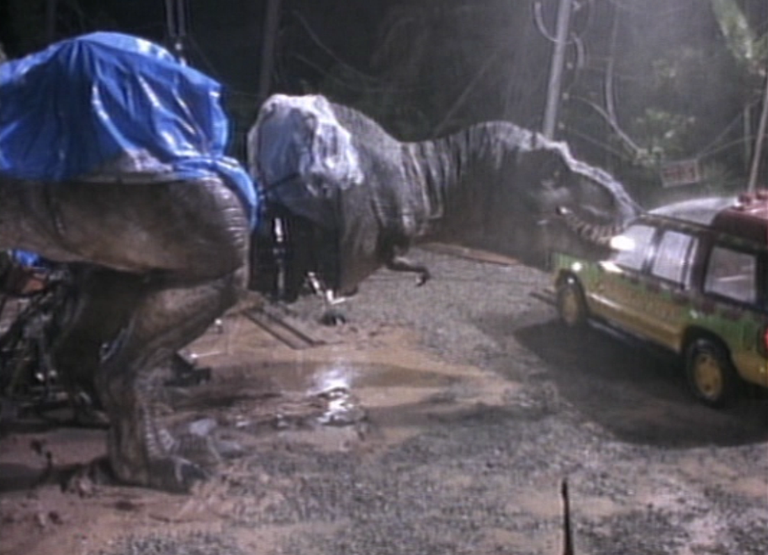
Mechanical
Animatronic
Animated objects
Jurassic Park - Tyrannosaurus rex
Notes:
Animatronics refers to the use of robotic devices to emulate a human or an animal, or bring lifelike characteristics to an otherwise inanimate object.^{[1][2]} A robot designed to be a convincing imitation of a human is more specifically labeled as an android.^{[3][4][5]} Modern animatronics have found widespread applications in movie special effects and theme parks and have, since their inception, been primarily used as a spectacle of amuseme

Slide 5
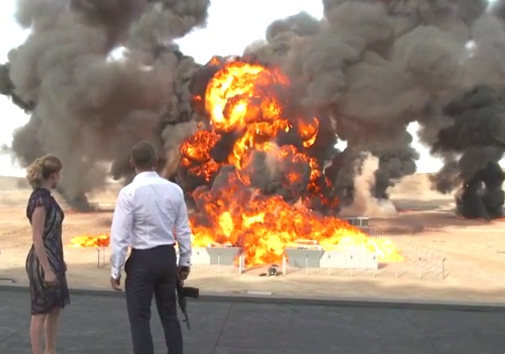
Chemical
Fire
Mist
Explosions
Etc.
James Bond (Spectre) - Explosion

Slide 6
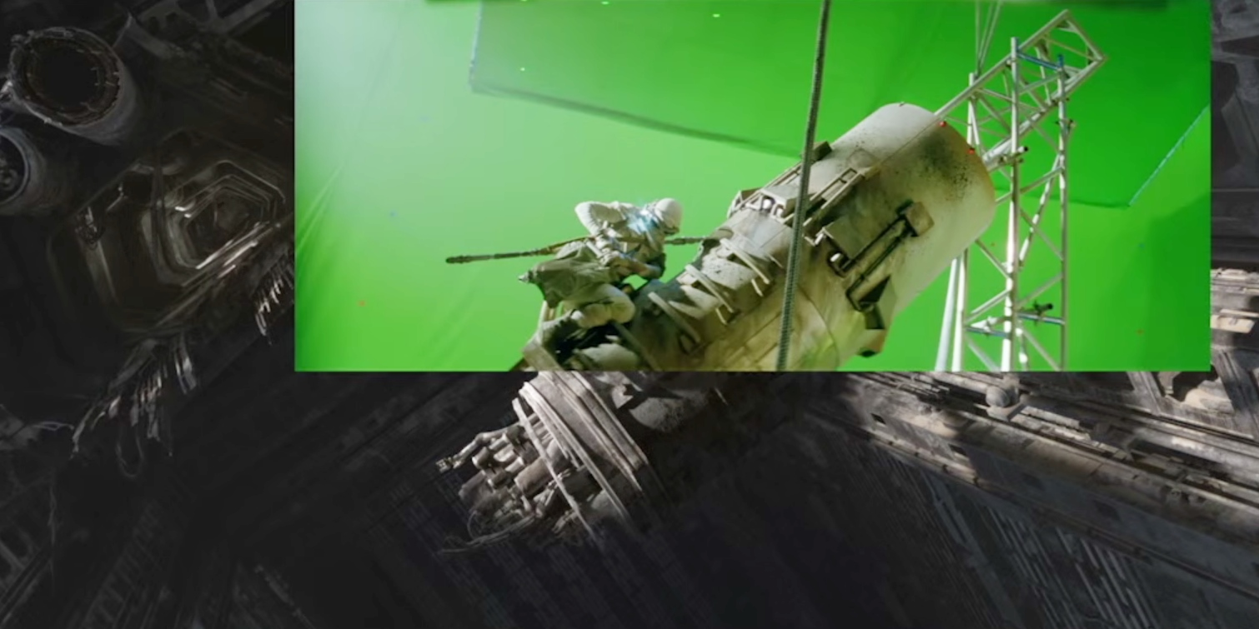
Computerized
CGI (computer generated imagery)
Star Wars : The force awakens

Slide 7
« Future of the cinema »
Notes:
But how will those special effects gets any improvement, what is the future of the cinema using the next gens speccical effects
Let show you few exemples what is the future of the cinema

Slide 8
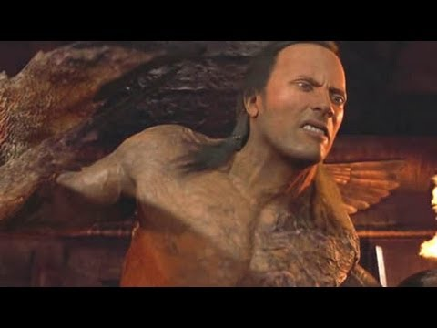
The mummy – Scorpion king made out of CGI
BAD CGI

Slide 9

The move to HD and 4K make CGI less convincing
CGI looks realistic in SD
You can see the CGI in HD
Notes:
CGI is far from perfect. But when the delivery format was celluloid and SD, it masked the imperfections of CGI and made everything look more realistic. Filmmakers furthered the illusion by purposely compositing CGI into poorly lit scenes and behind elements like smoke and rain. Now with the stunning clarity of 2K and 4K (and even more so with HFR), we’re starting to see the cracks in the pavement. As resolution increases, CGI is becoming less convincing.

Slide 10
CGI, CGI, CGI and CGI
CGI is (not) the answer
No restraints
CGI encourages lazy filmmaking

Slide 11
Conclusion
CGI is used everywhere, and will be used over and over.
Special effects are just a way to make the movie more immersive.
What could be the next kind of « special effect » ?

